Slide 1
Sleep Health and Lifestyle
Dataset Analysis
Prepared by: Parthiv Thakur

Slide 2
Project Overview
Goal: Analyze sleep health and lifestyle factors using the given dataset.
Dataset contains personal, health, lifestyle, and sleep disorder attributes.
Graphs are taken directly from the original Project.ipynb notebook outputs.
Analysis focuses on sleep duration, quality of sleep, stress level, BMI, occupation, gender, blood pressure, heart rate, and daily steps.
Sleep Health and Lifestyle Dataset Analysis | 2

Slide 3
Dataset Summary
374
Records
13
Columns
42.2
Avg Age
7.13 h
Avg Sleep Duration
7.31/10
Avg Quality
5.39/10
Avg Stress
77
Insomnia
78
Sleep Apnea
No recorded disorder / blank Sleep Disorder values: 219 records
Sleep Health and Lifestyle Dataset Analysis | 3

Slide 4
Methodology
1. Load dataset using pandas.
2. Check dataset information, statistical summary, and missing values.
3. Use Matplotlib and Seaborn visualizations from Project.ipynb.
4. Study relationships between lifestyle variables and sleep disorder categories.
5. Summarize findings using extracted notebook graphs.
Sleep Health and Lifestyle Dataset Analysis | 4

Slide 5
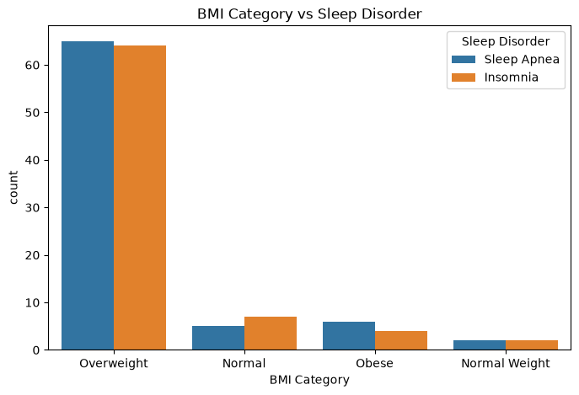
BMI Category vs Sleep Disorder
Interpretation
This graph compares sleep disorder records across BMI categories. Overweight records have the highest number of both Insomnia and Sleep Apnea cases, showing that BMI category is an important lifestyle factor in the dataset.
Sleep Health and Lifestyle Dataset Analysis | 5

Slide 6
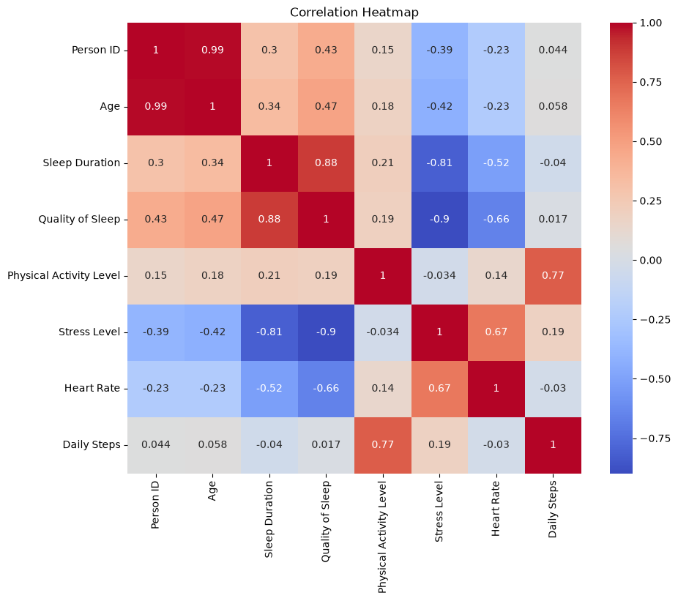
Correlation Heatmap
Interpretation
The heatmap shows relationships among numerical variables. Sleep Duration and Quality of Sleep are strongly positively related, while Stress Level is strongly negatively related to both Sleep Duration and Quality of Sleep.
Sleep Health and Lifestyle Dataset Analysis | 6

Slide 7
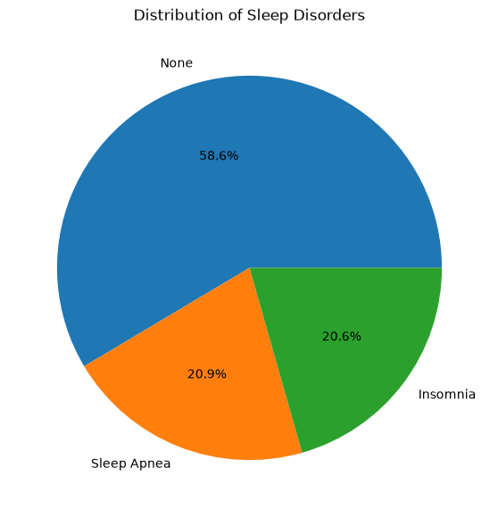
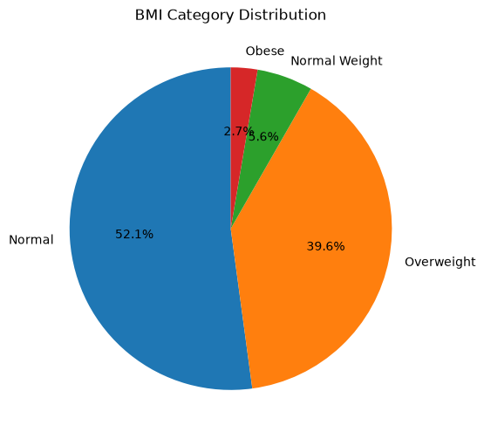
Sleep Disorder and BMI Category Distribution
Distribution of Sleep Disorders
BMI Category Distribution
Key point: the paired notebook graphs show the distribution and comparison pattern from the dataset.
Sleep Health and Lifestyle Dataset Analysis | 7

Slide 8
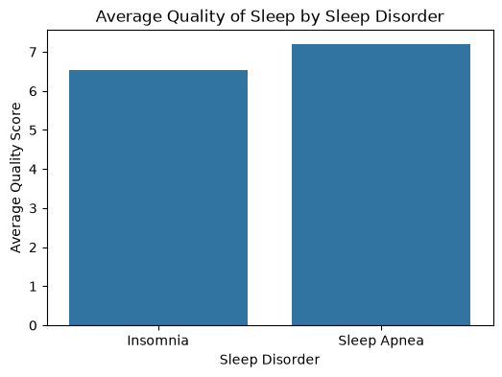
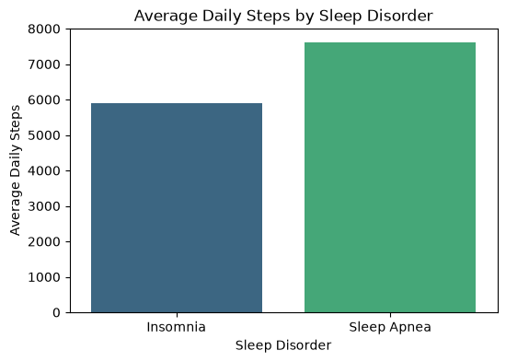
Average Quality and Daily Steps by Sleep Disorder
Average Quality of Sleep by Sleep Disorder
Average Daily Steps by Sleep Disorder
Key point: Insomnia has lower sleep quality, while daily steps differ across disorder groups.
Sleep Health and Lifestyle Dataset Analysis | 8

Slide 9
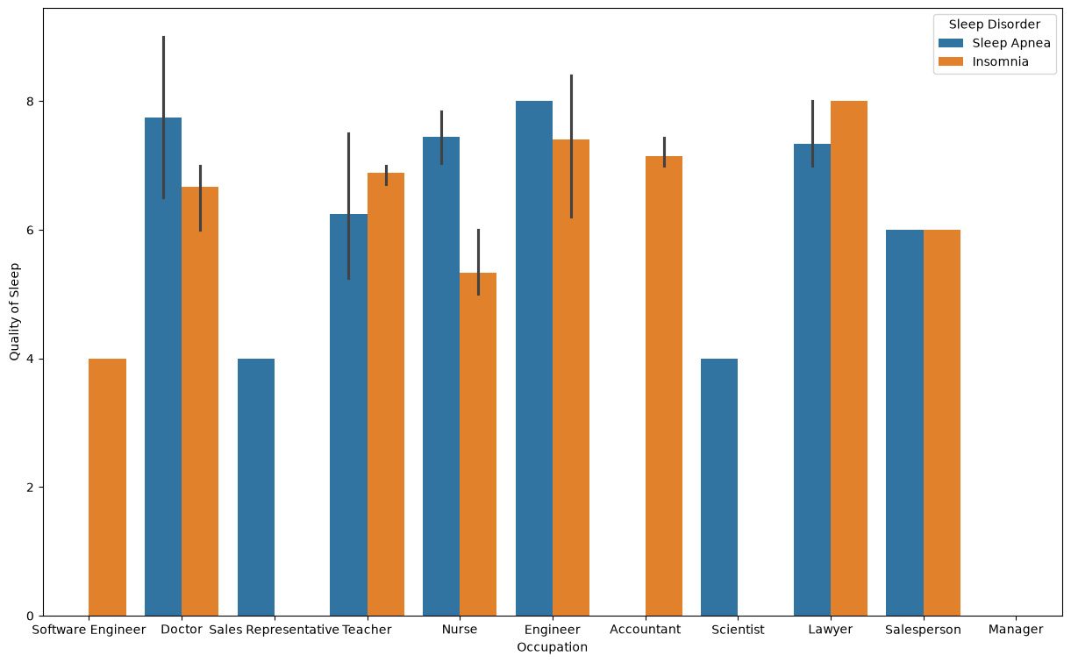
Occupation vs Quality of Sleep by Sleep Disorder
Interpretation: This occupation-based chart helps compare how sleep quality differs across professions and sleep disorder groups. It shows that the effect of sleep disorder is not uniform across occupations.
Sleep Health and Lifestyle Dataset Analysis | 9

Slide 10
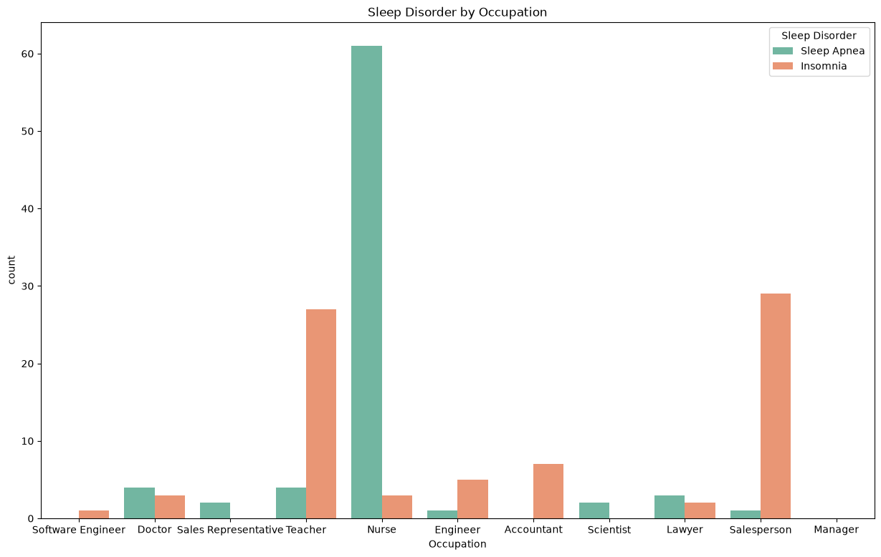
Sleep Disorder by Occupation
Interpretation: This count plot shows which occupations contain more sleep disorder records. Nurse, Teacher, and Salesperson categories show a visible concentration of disorder cases in the dataset.
Sleep Health and Lifestyle Dataset Analysis | 10

Slide 11
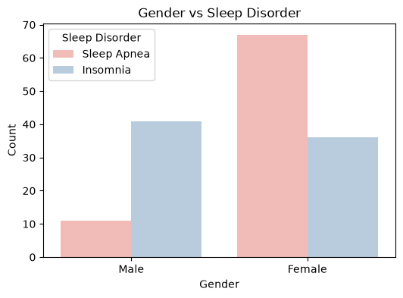
Gender vs Sleep Disorder
Interpretation
This graph compares recorded sleep disorders by gender. Female records show a higher number of Sleep Apnea cases, while male records show more Insomnia cases in this dataset.
Sleep Health and Lifestyle Dataset Analysis | 11

Slide 12
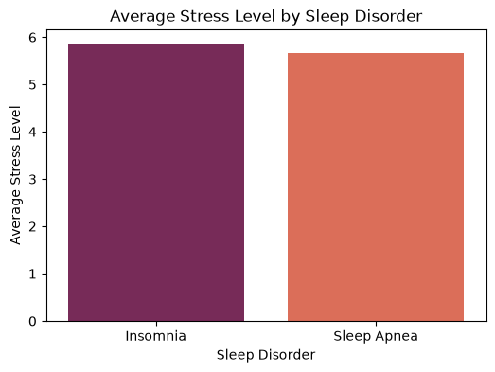
Average Stress Level by Sleep Disorder
Interpretation
This bar chart shows that both Insomnia and Sleep Apnea groups have higher average stress levels than the no-disorder group, supporting the link between stress and sleep health.
Sleep Health and Lifestyle Dataset Analysis | 12

Slide 13
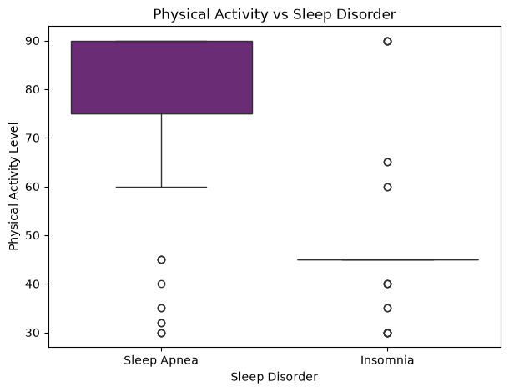
Physical Activity vs Sleep Disorder
Interpretation
The boxplot compares physical activity distribution for each sleep disorder group. Sleep Apnea records show higher physical activity levels, while Insomnia records are lower on average.
Sleep Health and Lifestyle Dataset Analysis | 13

Slide 14
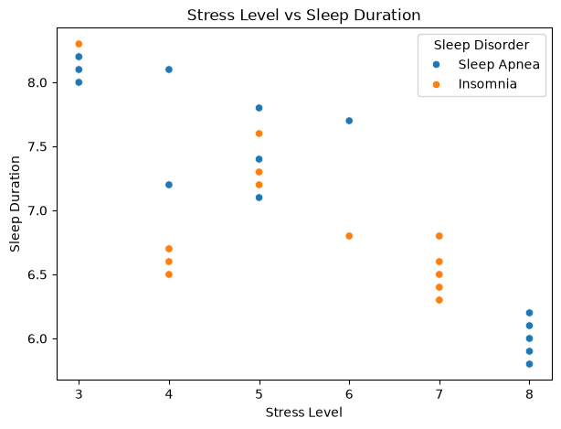
Stress Level vs Sleep Duration
Interpretation
This scatter plot shows that higher stress levels generally appear with shorter sleep duration. It supports the negative relationship between stress and sleep duration shown in the correlation heatmap.
Sleep Health and Lifestyle Dataset Analysis | 14

Slide 15
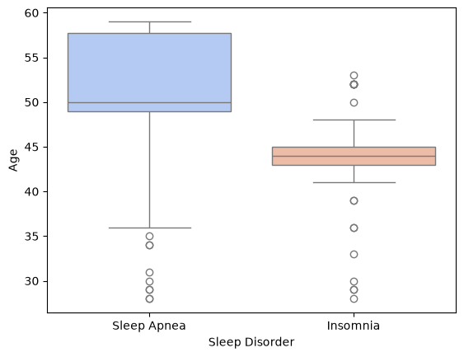
Sleep Disorder vs Age
Interpretation
The age boxplot shows the age range of people in each sleep disorder group. Sleep Apnea appears more common among older records, while Insomnia is concentrated around middle age.
Sleep Health and Lifestyle Dataset Analysis | 15

Slide 16
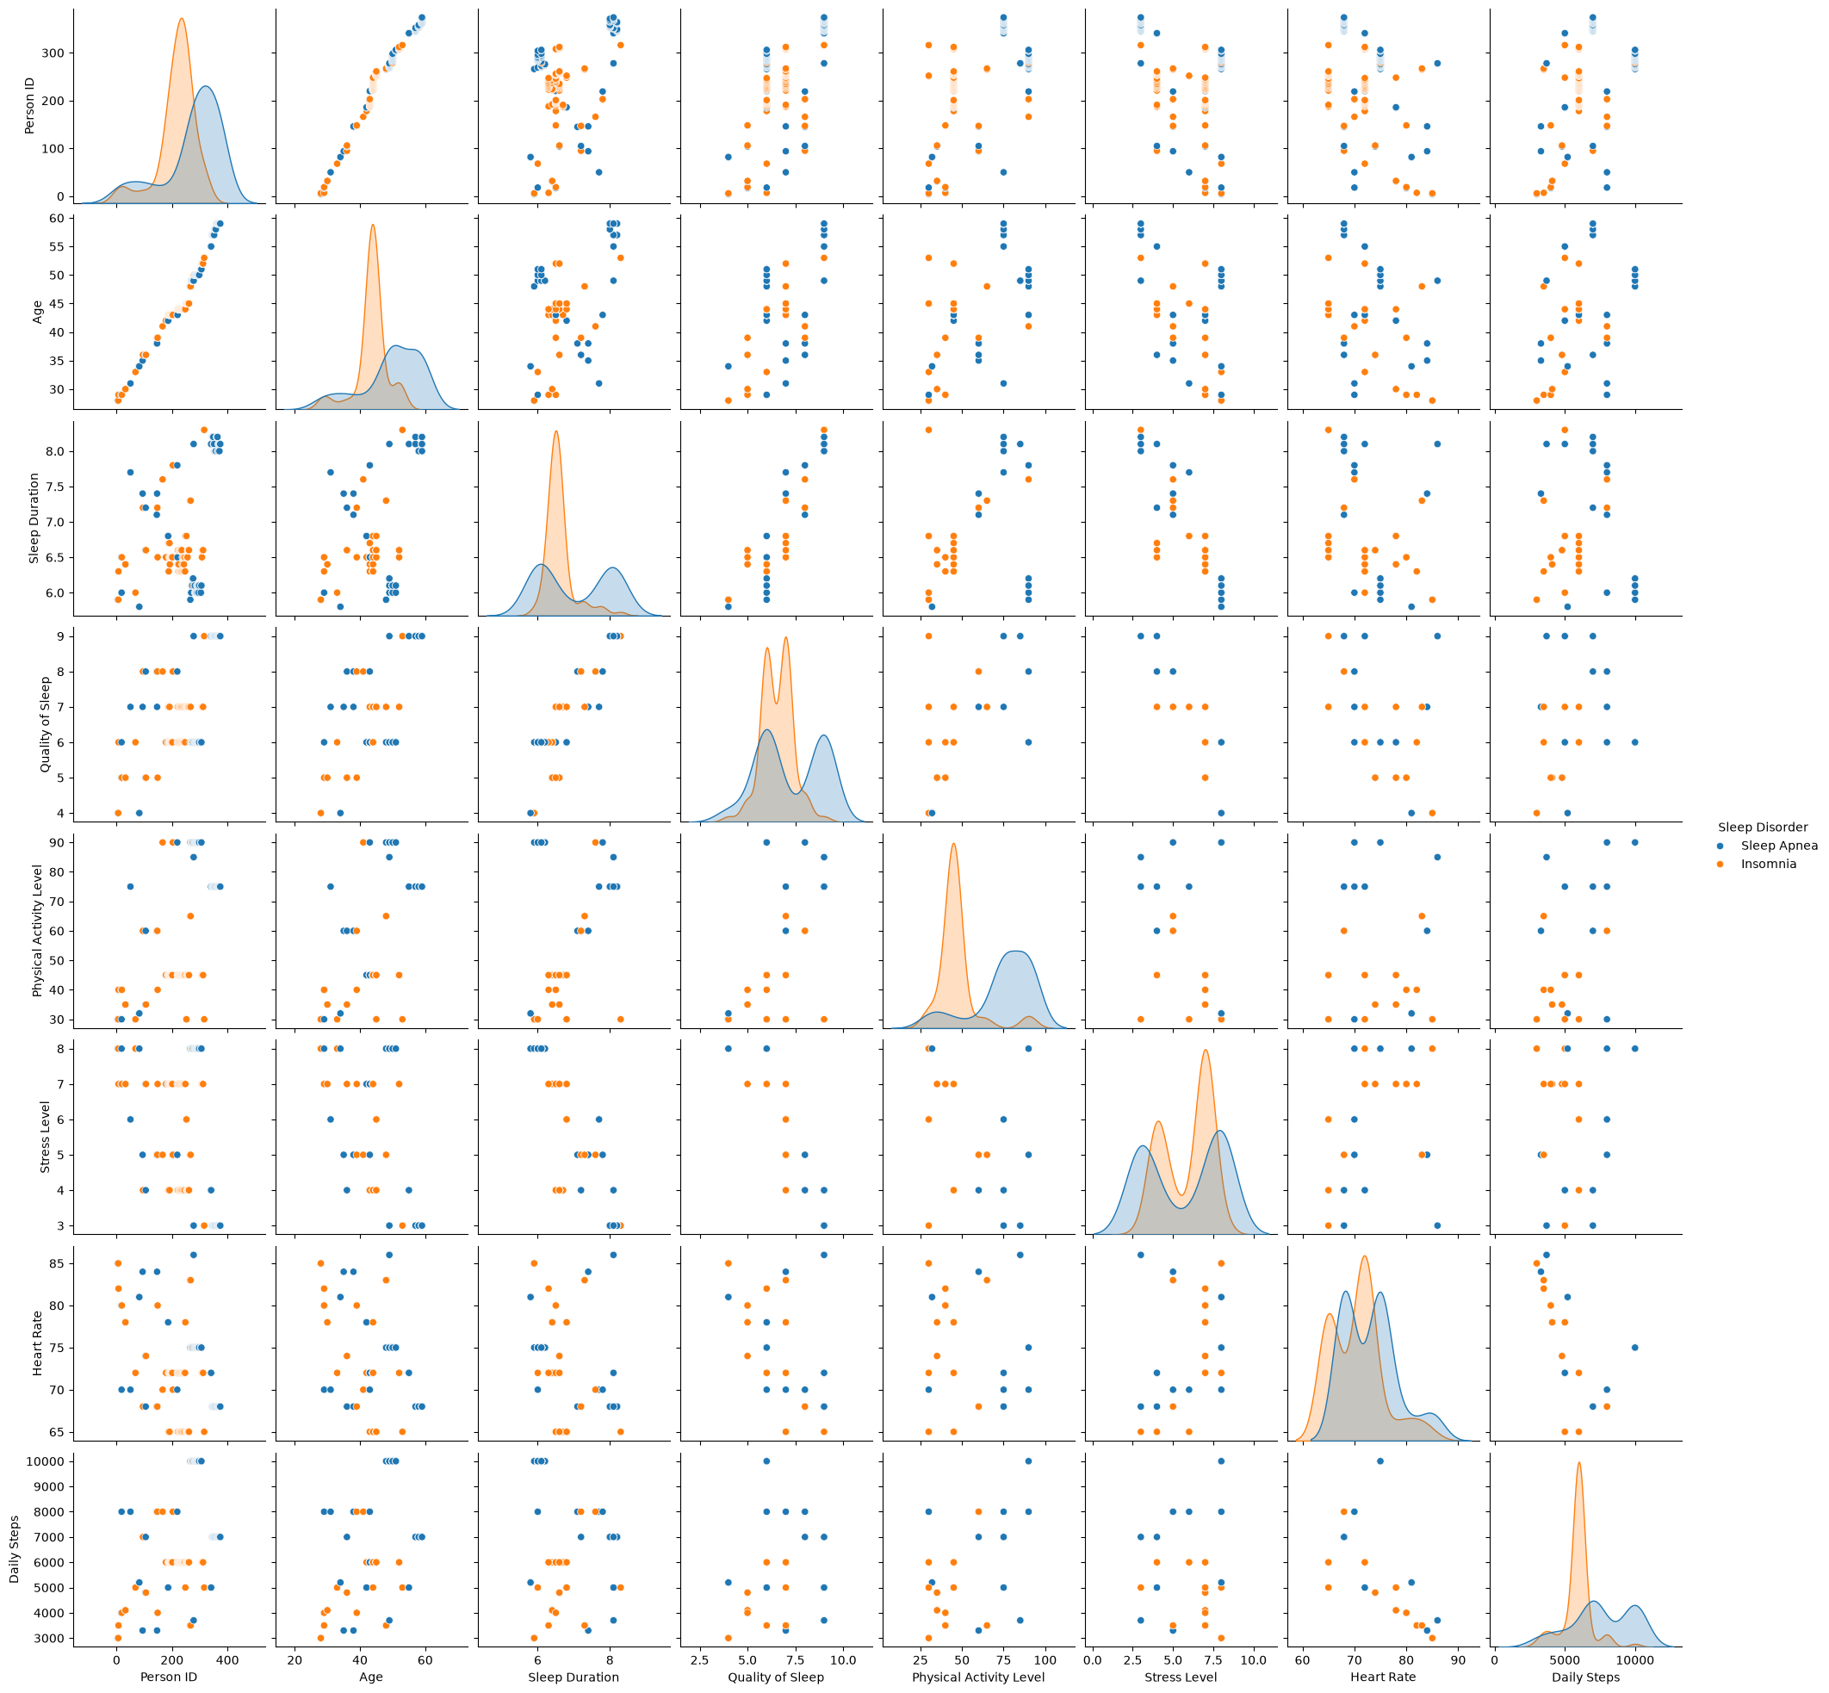
Pairplot of Numeric Variables by Sleep Disorder
Interpretation: The pairplot gives an overall comparison of numeric variables. It helps identify patterns such as stress increasing when sleep duration and sleep quality decrease.
Sleep Health and Lifestyle Dataset Analysis | 16

Slide 17
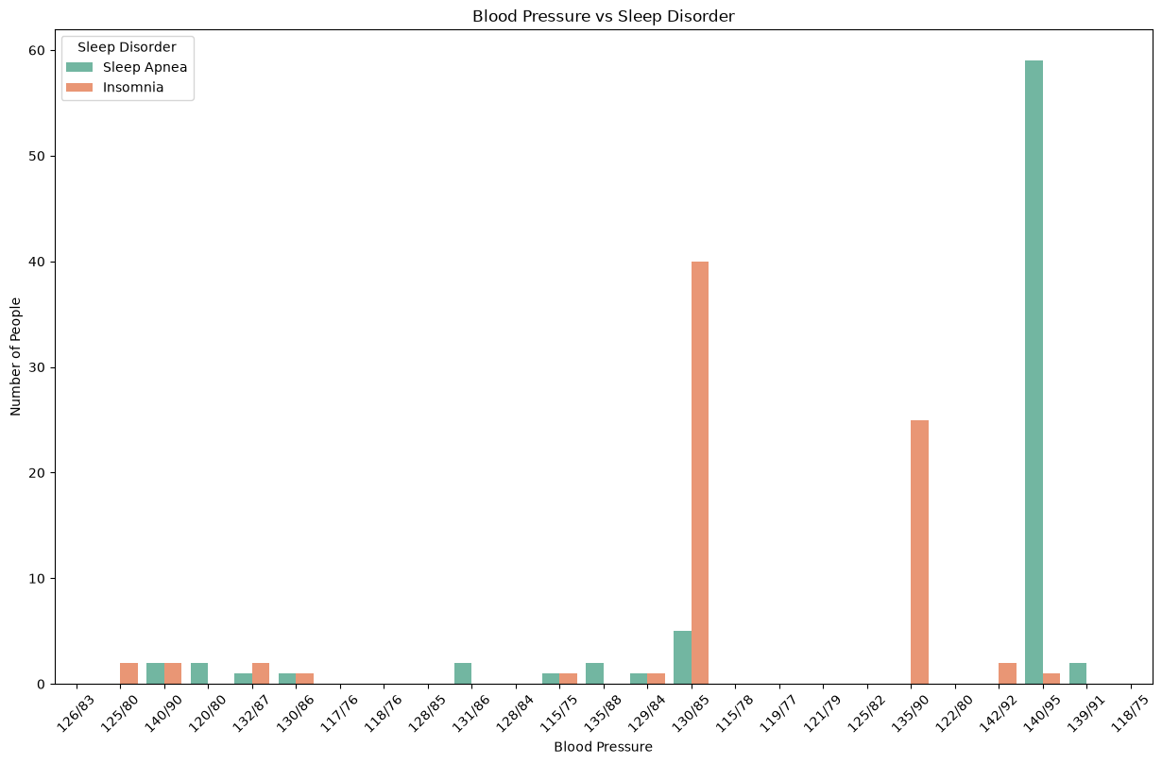
Blood Pressure vs Sleep Disorder
Interpretation: This count plot compares blood pressure readings with sleep disorder categories. Some higher blood pressure readings, such as 140/95, are strongly visible in Sleep Apnea records.
Sleep Health and Lifestyle Dataset Analysis | 17

Slide 18
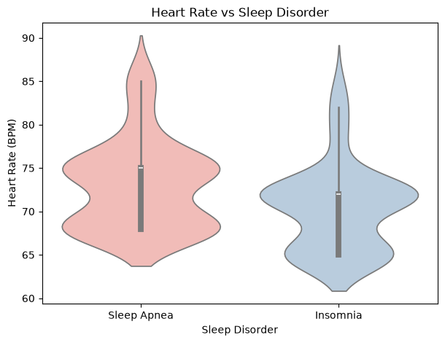
Heart Rate vs Sleep Disorder
Interpretation
The violin plot compares heart-rate distribution across sleep disorder groups. Sleep Apnea records show a higher average heart rate than the no-disorder and Insomnia groups.
Sleep Health and Lifestyle Dataset Analysis | 18

Slide 19
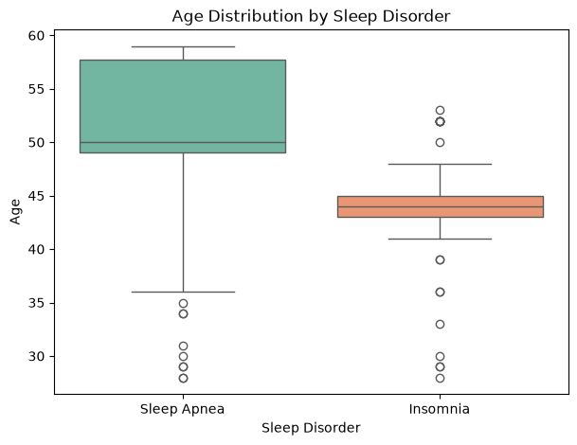
Age Distribution by Sleep Disorder
Interpretation
This boxplot repeats the age comparison with clearer labels. It highlights that Sleep Apnea records are generally older than Insomnia and no-disorder records.
Sleep Health and Lifestyle Dataset Analysis | 19

Slide 20
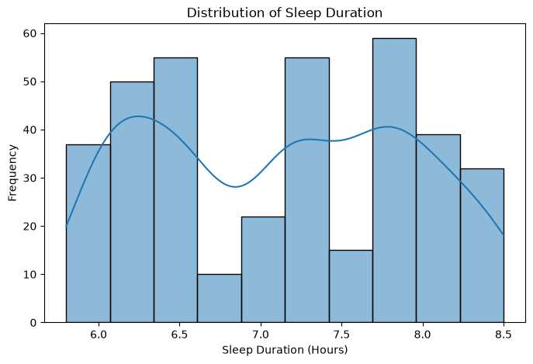
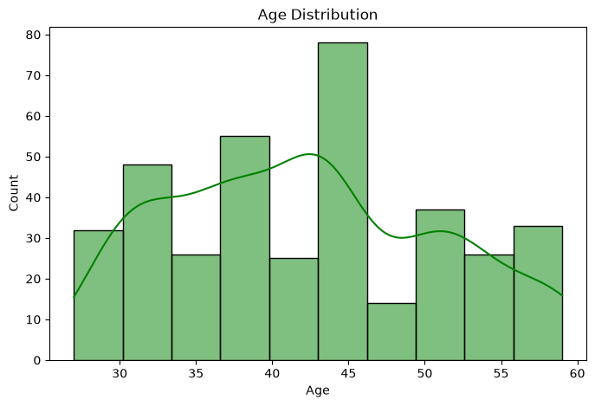
Sleep Duration and Age Distributions
Distribution of Sleep Duration
Age Distribution
Key point: the paired notebook graphs show the distribution and comparison pattern from the dataset.
Sleep Health and Lifestyle Dataset Analysis | 20

Slide 21
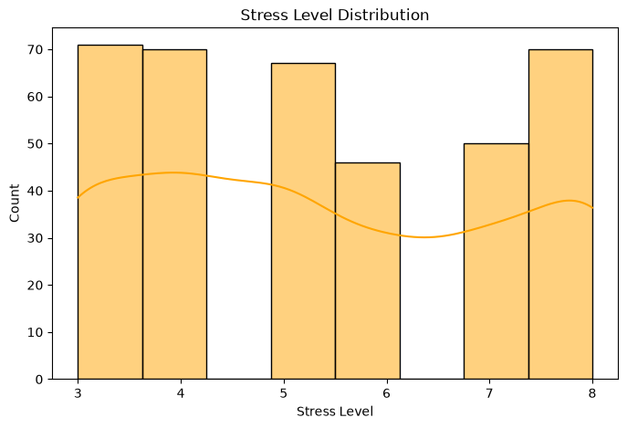
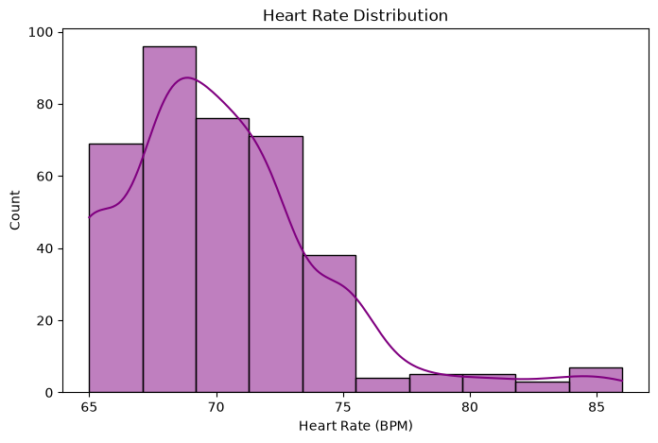
Stress Level and Heart Rate Distributions
Stress Level Distribution
Heart Rate Distribution
Key point: the paired notebook graphs show the distribution and comparison pattern from the dataset.
Sleep Health and Lifestyle Dataset Analysis | 21

Slide 22
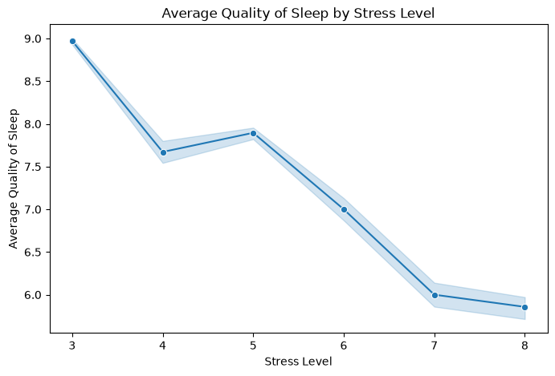
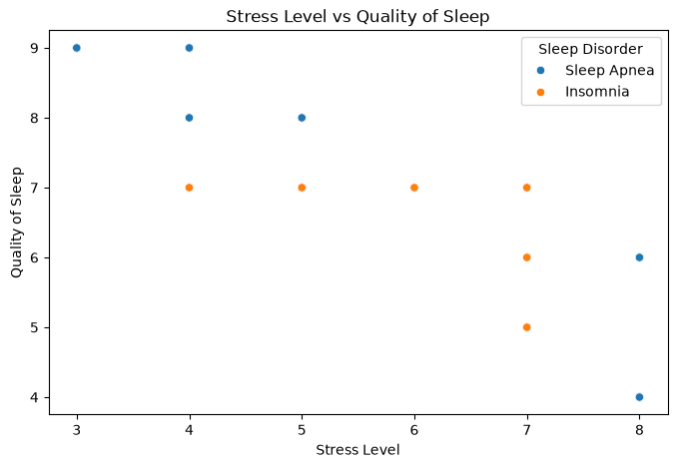
Stress Level and Sleep Quality Relationship
Average Quality of Sleep by Stress Level
Stress Level vs Quality of Sleep
Key point: higher stress level is associated with lower average sleep quality.
Sleep Health and Lifestyle Dataset Analysis | 22

Slide 23
Main Findings
Higher stress level is strongly linked with lower sleep duration and lower quality of sleep.
Sleep duration and quality of sleep show a strong positive relationship.
Overweight records contain a high number of Insomnia and Sleep Apnea cases.
Sleep Apnea records are more frequent among older records and show higher average heart rate.
Occupation and gender show visible differences in recorded disorder patterns.
Sleep Health and Lifestyle Dataset Analysis | 23

Slide 24
Conclusion
The analysis shows that sleep health depends on multiple lifestyle and health factors. Stress level is the most important visible factor because it decreases sleep duration and sleep quality. BMI category, occupation, gender, blood pressure, age, heart rate, physical activity, and daily steps also show meaningful patterns with sleep disorder categories in the dataset.
Final Result
Better sleep quality is associated with lower stress, proper sleep duration, and better lifestyle balance.
Sleep Health and Lifestyle Dataset Analysis | 24

